Slide 1
Ad-Blocking Middleware
- A centralized Ad Blocker

Slide 2
Introduction
Hardware & Software Requirements
01
04
Literature Review
Planned Schedule
02
05
Block Diagram/Flowchart
References
03
06
Problems faced & the Solution we Propose!
List of necessary Hardware along with Cost
Research Papers to Understand the concepts
Time Frame planned to complete activities
Conceptual System Design
Additional References

Slide 3
Introduction
Online Advertisements constitute an important part of the Internet ecosystem, forming the economic lifeblood of many largest global technology companies such as Google and Facebook. Also they pose a threat to security and also compromise performance and efficiency.
So, to protect our own privacy we have proposed a system which
Block ads for any device connected to that network
Allows to control the services which the extensions cannot do
Utilizes Pi-Hole as open-source software that runs on Raspberry Pi
Allows user to blacklist a set of websites or a group of web pages

Slide 4
Title | Authors | Year of Publication | Overview
IMDoC: Identification of Malicious DomainCampaigns via DNS and Communicating Files | Craig E. Wills Doruk C. Uzunoglu | 2016 | The paper lists a few techniques to counter cyber attacks via DNS such as Use of Physical DNS and also states its limitations.Proposes improved methods i) Detection based on Communicating files. ii) Detection from a specific malware campaign based on DNS data. IMDoC algorithm and its real time evaluation
Toward Detecting Malicious Links in Online Social Networks through User Behavior | Bandar Alghamdi, Jason Watson, Yue Xu | 2016 | The paper focuses on classification of URL based on URL features such as Lexical,Hot-based, Domain Based, OSN based features and many more. Model for detection of malicious URL based on Data collection, Feature extraction and URL classification
Ads-Block Management System Using Open Virtual Private Network on Ubuntu Operating System | Edy Rahman Syahputra , Boni Oktaviana Sembing , Arie Rafika Dewi | 2018 | Introduction to Online (Web) Advertising, Working of OSI Model, Concept of Open-Vpn. THe paper further discusses DNS in terms of Business of DNS and DNS Tunneling. It states methods to classify Ad requirements along with the achieved results
Ad-Blocking with AdGuard | Akshay Kadav, Sankalp Madhavi, Tejas Gorivale and Dr. Vrajesh Maheta | 2021 | This paper introduced the system called AdGuard where Ads can be blocked at DNS level using DNS masq, Flask, FTL, etc packages
Development of Rasberry Pi 3 Content Filtering and Ads Blocker | Lukmanulhakim bin Ngah, Ahmad Shakawi Ahmad Sanusi | 2021 | System that blocks Ads and allows parents to manage and monitor all the internet activities of their children easily and effectively without buying a third-party expensive product. Uses Raspberry pi 3 Model B
Network-wide range ad-blocker using raspberry pi | Sanoaf Dheen N, Sapthagiri M, Naveenkumar A and Sathya Narayanan K | 2018 | This paper has described the use of Raspberry Pi, router, keyboard (For initial set up) and Ethernet cable to build up the ad-blocker framework.

Slide 5
Title | Authors | Year of Publication | Overview
A STUDY ON IPv4 and IPv6: THE IMPORTANCE OF THEIR CO-EXISTENCE | Kinn Abass Bakon, Henry Chukwuemeka Paul | 2016
Domain Name System (DNS) Security: Attacks Identification and Protection Methods | Sanjay Adiwal Balaji Rajendran | 2018
Security of the DNS Protocol | Kaouthar Chetioui, Ghizlane Orhanou, | 2017
AdBlock Plus Efficacy Study. Technical Report | Arvind Parmer, Malcolm Toms, Costa Dedegikas, Christopher Dickert. | 2015 | Online advertising represents the economic foundation for much of the Internet’s content; however, it is problematic not only for individual users. This paper contains the study of Adblock Plus which is an open-source Internet Browser extension.
Pi Black Hole for Internet Advertisements. | Rhythm Kr Dasgupta | 2018 | Pi Black-hole is a device collection of a set of software packages that provide filtering and advertisement blocking for all internet services on your network.It uses dnsmasq, lighttpd, FTL and some other packages to tie all this together into a nice, easy-to-use web interface.
Ad Block and Malicious URL Detection System | Aditya V Shetty, Algeena Carol Dsouza, Aditya Maruti Naik, Reena Lobo | 2019 | Verifying redirection of web pages by the User. Blocking annoying ads. Alerting the user before entering an unsecured site. JavaScript and Jason for pattern matching for malicious url detection and to recognize ad patterns to block those ads.

Slide 6
Title | Authors | Year of Publication | Overview
Security of the DNS Protocol | Kaouthar Chetioui, Ghizlane Orhanou | 2020
Adblocking: advertising 'accounts for half of data used to read articles' | Article: The Guardian | 2016
Advertisement Blocker using Raspberry pi | S. Gokul , R. Loganath. J. Kodeeswaran K.S. Ranjgith, Dr.A.Mohanbabu | 2020
What Ad Blockers Are (and Are Not) Doing | Craig E. Wills Doruk C. Uzunoglu | 2016
The evaluation of AdBlock technique implementation for enterprise network environment | Mohd Iskandar Bin Samsuddin,Mohamad Yusof Darus,Shamsul J Elias,Abidah Hj Mat Taib,Norkhushaini Awang, Roshidi Din | 2019

Slide 7
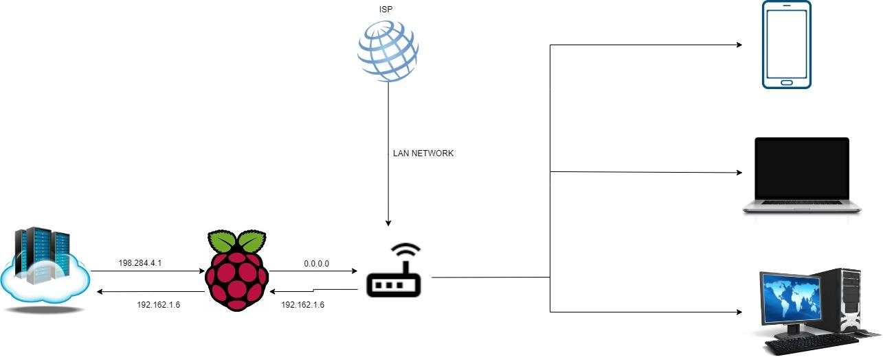
Block Diagram

Slide 8

Hardware Requirements
Raspberry Pi
PR
Online
Jupiter is a gas giant and the biggest planet in the Solar System
Venus has a beautiful name and is the second planet from the Sun
Despite being red, Mars is actually a cold place full of iron oxide dust

Slide 9
Software Requirements
Advertising
PR
Online
Jupiter is a gas giant and the biggest planet in the Solar System
Venus has a beautiful name and is the second planet from the Sun
Despite being red, Mars is actually a cold place full of iron oxide dust

Slide 10
Planned Schedule
Sr. No. | Details of activity | Planned Start date | Planned Finish date | Name of Responsible Team Members
1 | Discussion on Domain and Topic to be selected & finalizing the topic | 14/03/2022 | 19/03/2022 | All
2 | Consulting with Project guide and planning | 20/03/2022 | 26/03/2022
3 | Research on selected topic and it’s implementation analyzing Hardware and software requirements | 27/03/2022 | 01/04/2022
4 | Preparing for Mid-semester review | 03/04/2022 | 09/04/2022
5 | Mid-Semester Review | 10/04/2022 | 13/04/2022
6 | Gathering required Hardware and preparing for the implementation | 18/04/2022 | 23/04/2022
7 | Project implementation | 24/04/2022 | 07/05/2022
8 | Project Documentation | 08/05/2022 | 14/05/2022
9 | Review of Guide and making necessary changes | 15/05/2022 | 21/05/2022
10 | Final Submission | 21/05/2022 | 24/05/2022

Slide 11
References
Craig E. Wills, Doruk C. Uzunoglu, “What Ad Blockers Are (and Are Not) Doing” , 2016
David Lazar and Kobi Cohen, “IMDoC: Identification of Malicious Domain Campaigns via DNS and Communicating Files”, March 2021
Bandar Alghamdi, Jason Watson, Yue Xu, “Toward Detecting Malicious Links in Online Social Networks through User Behavior” , 2016
Edy Rahman Syahputra,Boni Oktaviana Sembing, Arie Rafika Dewi,”Ads-Block Management System Using Open Virtual Private Network on Ubuntu Operating System” , 2018
Akshay Kadav, Sankalp Madhavi, Tejas Gorivale and Dr. Vrajesh Maheta, “Ad-Blocking with AdGuard”, 2021
Lukmanulhakim bin Ngah, Ahmad Shakawi Ahmad Sanusi, “Development of Rasberry Pi 3 Content Filtering and Ads Blocker”,2021
Sanoaf Dheen N, Sapthagiri M, Naveenkumar A and Sathya Narayanan K, “Network-wide range ad-blocker using raspberry pi”, 2018
Kinn Abass Bakon,Henry Chukwuemeka Pau, “A STUDY ON IPv4 and IPv6:THE IMPORTANCE OF THEIR CO-EXISTENCE”, 2016
Sanjay Adiwal, Balaji Rajendran “Domain Name System (DNS) Security: Attacks Identification and Protection Methods”, 2016
Arvind Parmer, Malcolm Toms, Costa Dedegikas, Christopher Dickert, “AdBlock Plus Efficacy Study. Technical Report”, 2015
Rhythm Kr Dasgupta , “Pi Black Hole for Internet Advertisements” , 2018

Slide 12
References
Aditya V Shetty, Algeena Carol Dsouza, Aditya Maruti Naik, Reena Lobo, “Ad Block and Malicious URL Detection System”, 2019
Kaouthar Chetioui, Ghizlane Orhanou, “Security of the DNS Protocol”, 2020
S. Gokul , R. Loganath, J. Kodeeswaran, K.S. Ranjgith, Dr.A.Mohanbabu , “Advertisement Blocker using Raspberry pi”, 202
Mohd Iskandar Bin Samsuddin,Mohamad Yusof Darus, “The evaluation of AdBlock technique implementation for enterprise network environment”, 2019

Slide 13

Harshal Sonawane Roll No.: 89
Mansi Patil Roll No.: 80
Shashank Patil Roll No.: 81
Bhavin Patil Roll No.: 78
Chaitanya Patil Roll No.: 79
Uma Thakur Roll No.: 91

